Slide 1
Servo Tensioning System on AFP Modular Heads
Owen Lu
Electroimpact

Slide 2
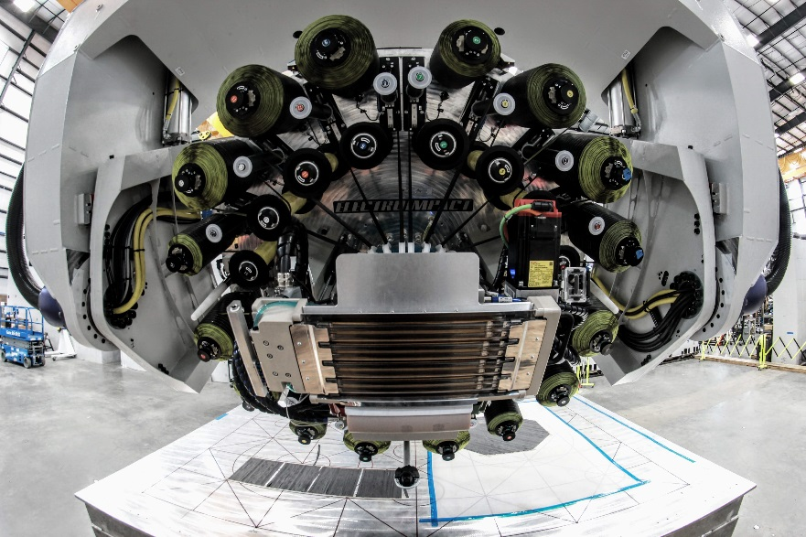
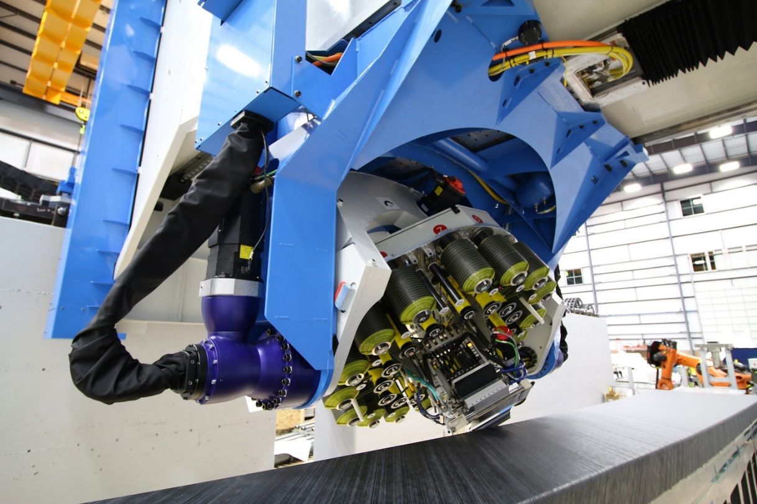
Example Modular Head

Slide 3
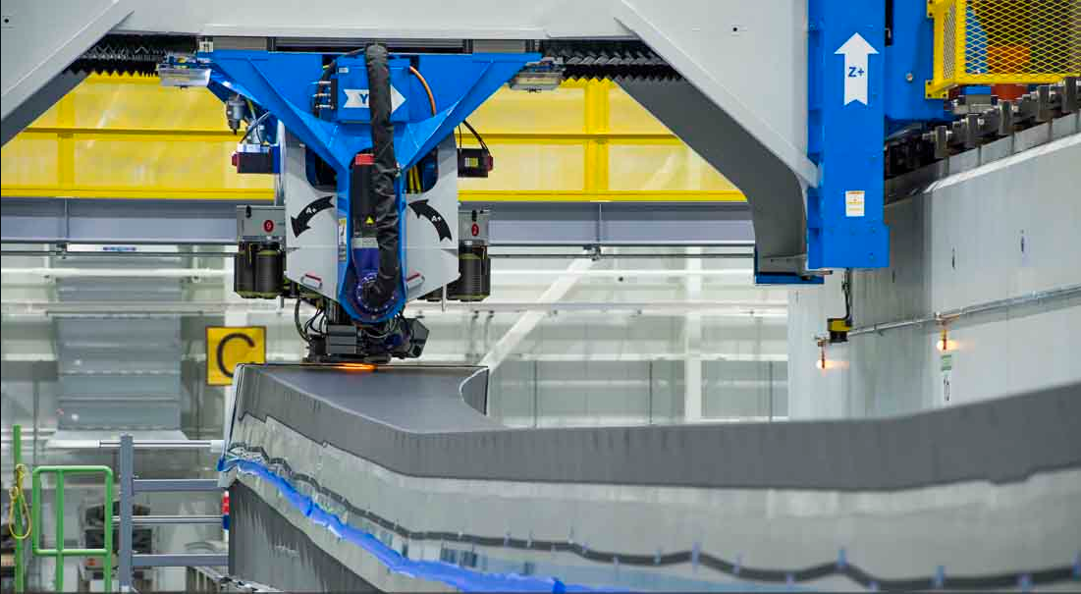
Motivation
Spars layup
High aspect ratio tool
Short courses (90 degree ply)
Long courses (0 degree ply)
Notes:
Short courses (90 degree ply)
Long courses (0 degree ply)
High sustained top speed
Tension control problems tend to occur during repeat acceleration cycles or high speed or both

Slide 4
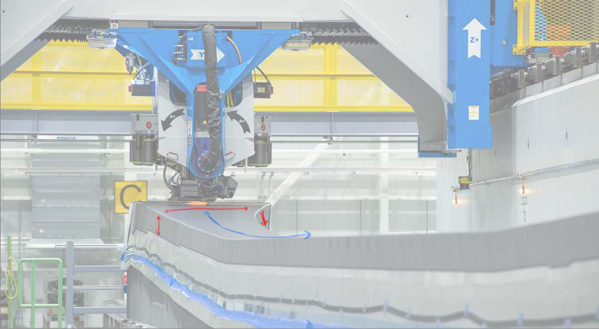
Motivation
Spars layup
High aspect ratio tool
Short courses (90 degree ply)
- High acceleration/cycles
Long courses (0 degree ply)
- High top speed

Slide 5
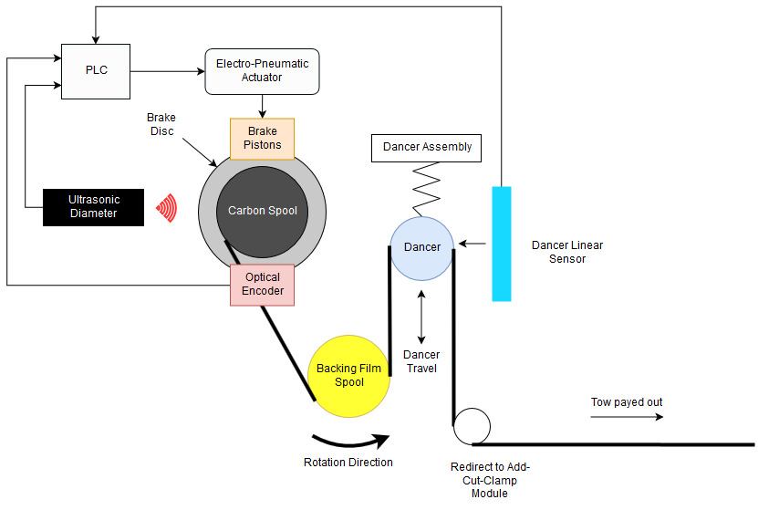
Previous generation architecture
Pneumatic tension control
Key Elements:
Feed motor accelerates the spool through tension
Servo pneumatic ITV’s control braking force

Slide 6
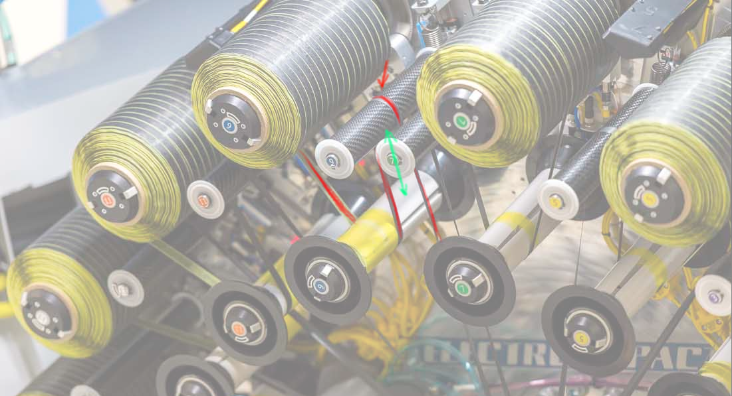
Process malfunctions
Process errors
Main Errors:
- Tow twisting
- Mechanical damage
Others:
Tangling
Tow buckling
Overlaps

Slide 7
Previous generation architecture
Goals:
↑ Reliability (MSBF)
↑ Add Speed/Cut Speed
↑ Top speed
↓ Average tension
*MSBF: Mean strips before failure

Slide 8
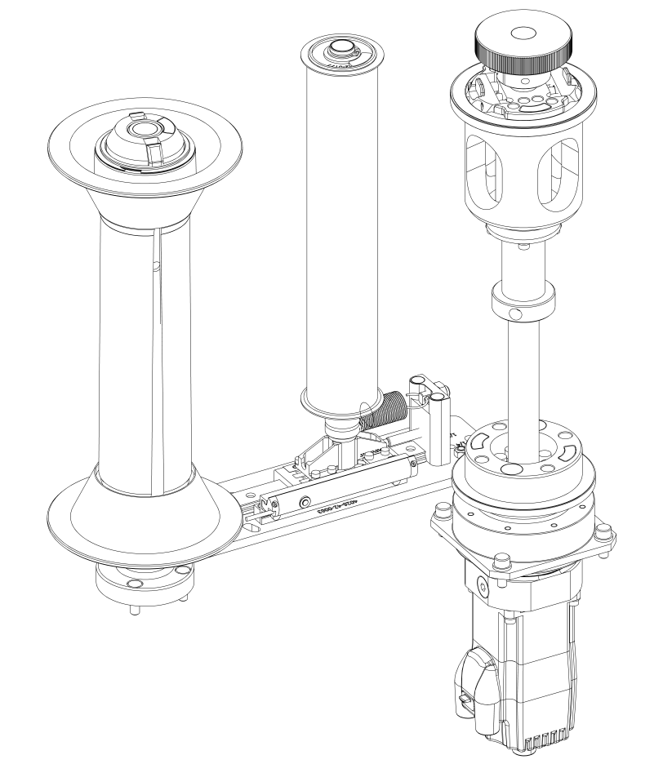
Servo Tensioning Solution
Goals:
↑ Reliability (MSBF)
↑ Add Speed/Cut Speed
↑ Top speed
↓ Average tension
(Patent Pending)

Slide 9

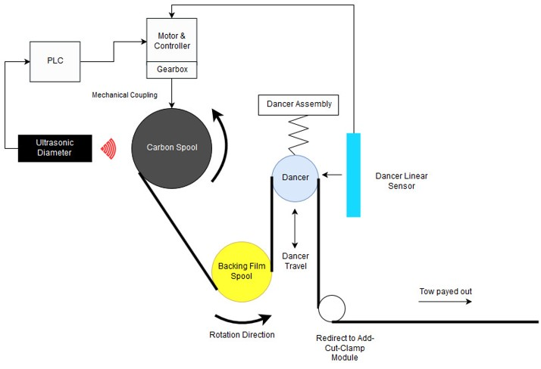
Architecture Comparison
PnEUMATIC
sERvo

Slide 10
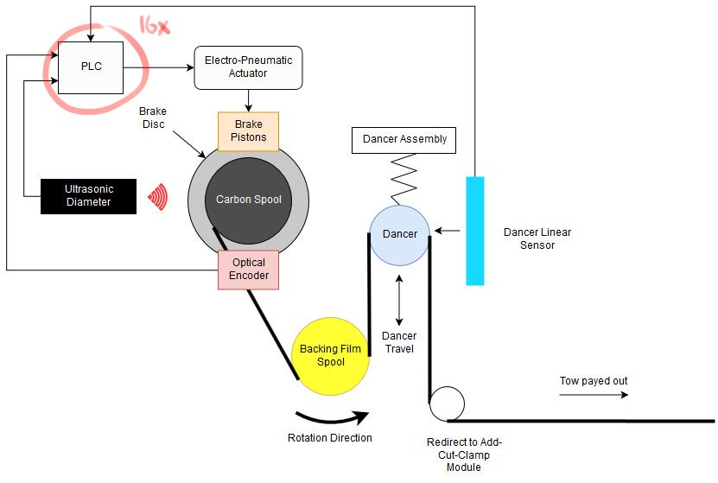
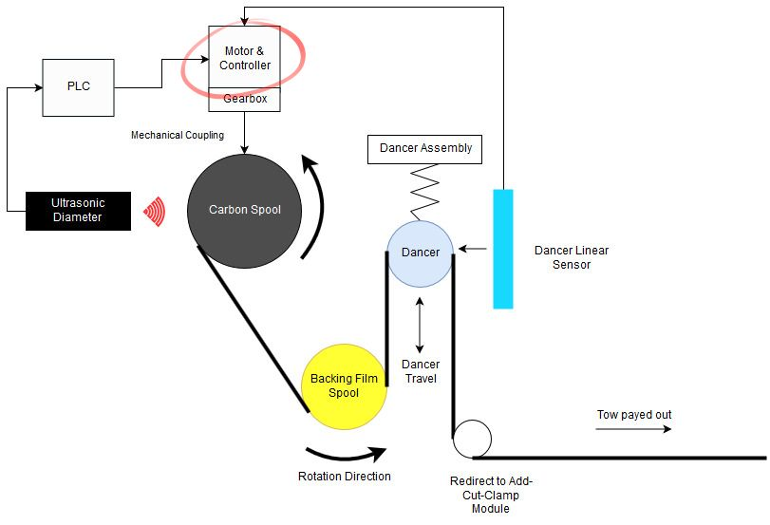
Decentralized Control
PnEUMATIC
sERvo

Slide 11
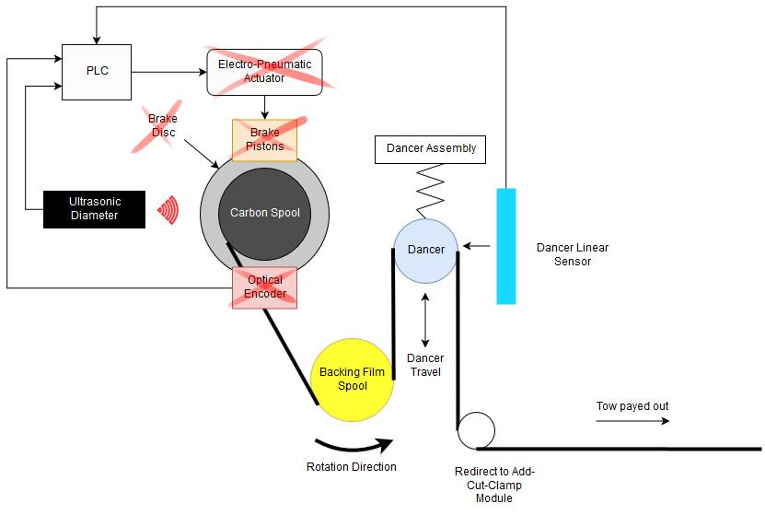
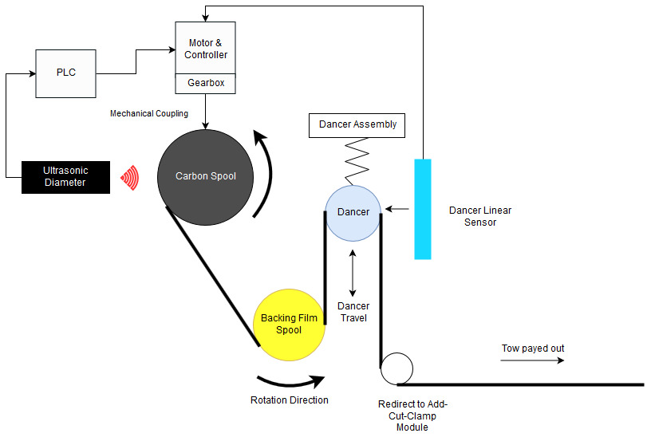
Component reduction
PnEUMATIC
sERvo

Slide 12
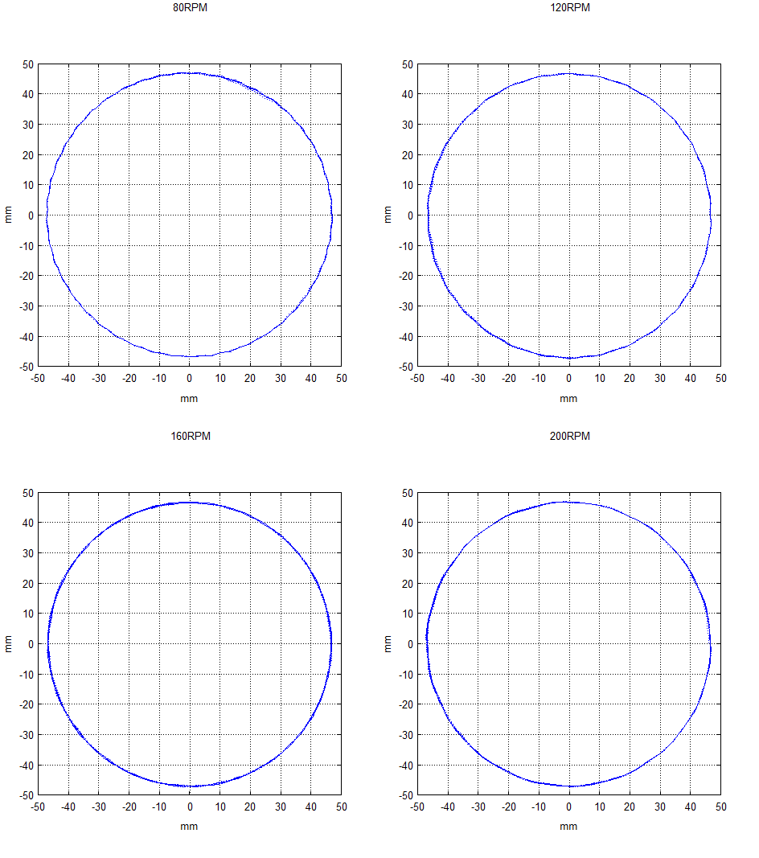
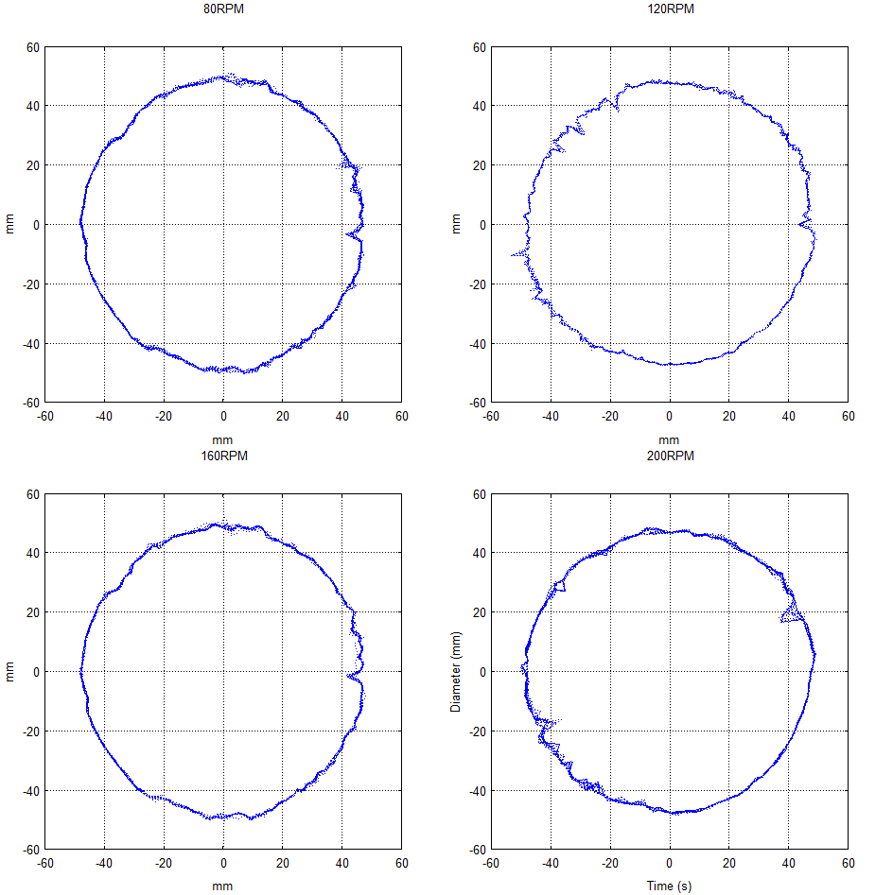
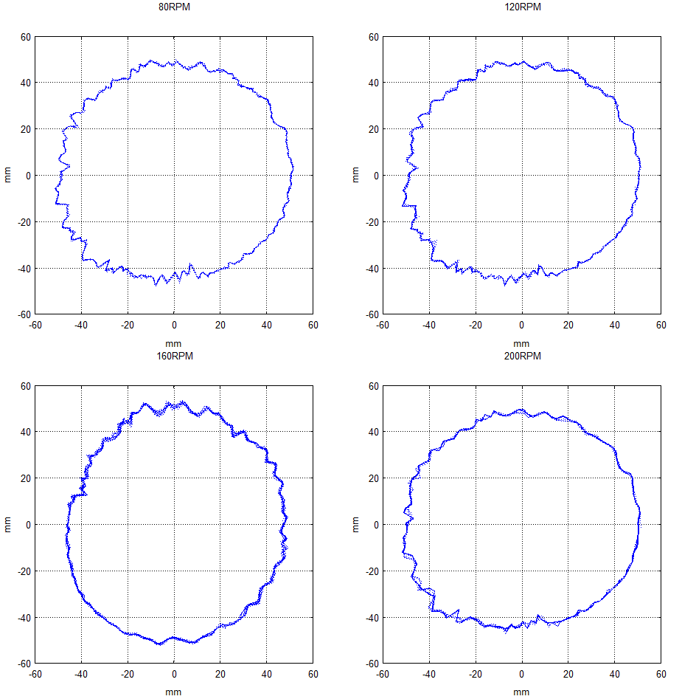
Diameter sensor selection
Ultrasonic
Laser Line
Laser Dot

Slide 13
Control structure
Key Ideas
Keep it simple
Purely feedback
Challenges
Inertia ratio > 100:1
Large diameter variation
Dancer stroke optimization
Optimize torque use

Slide 14
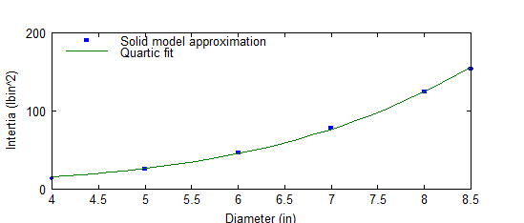
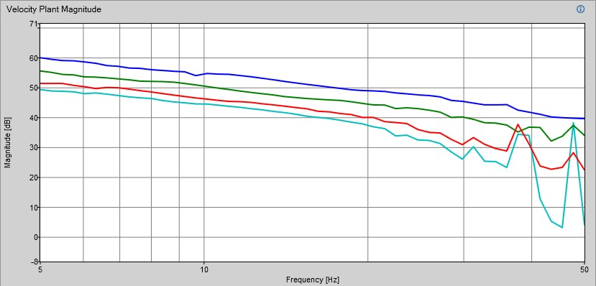
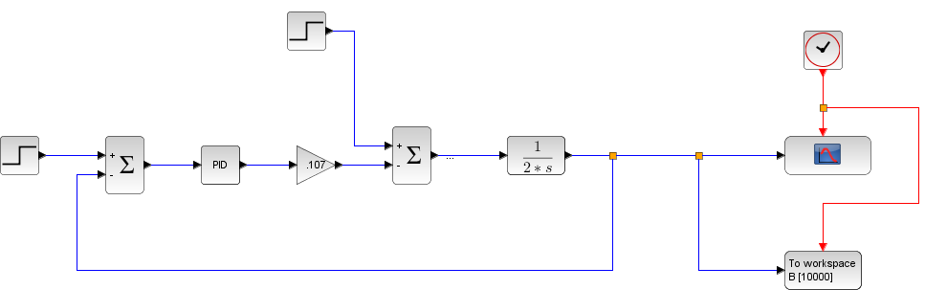
Torque estimation
Estimation
simulation
Verification

Slide 15
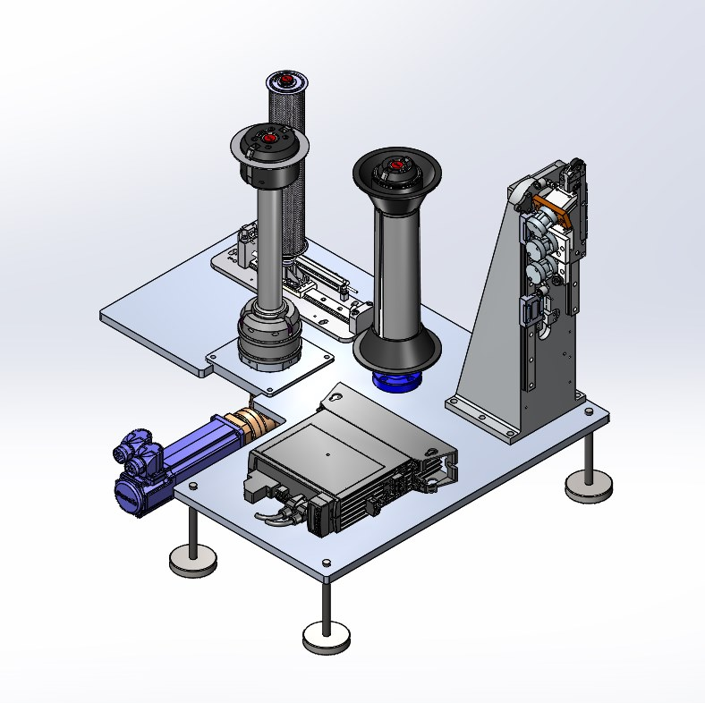
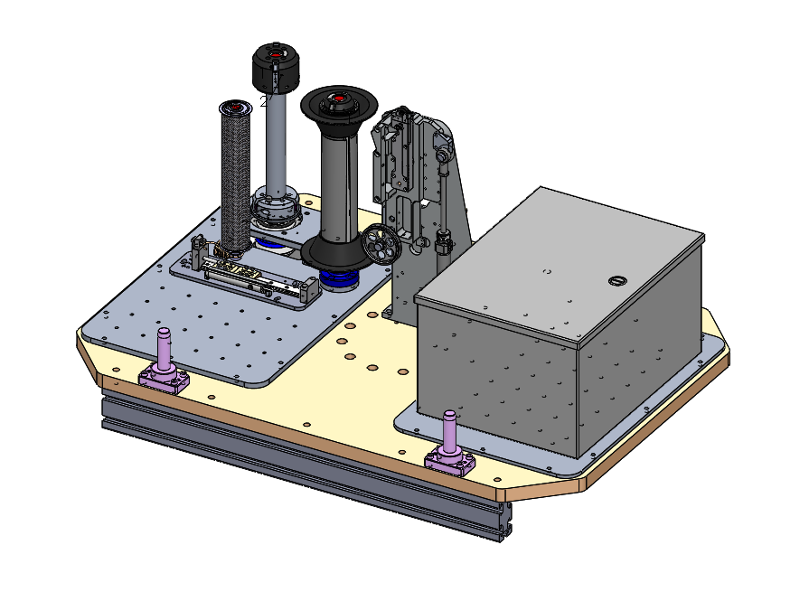
Test benches

Slide 16
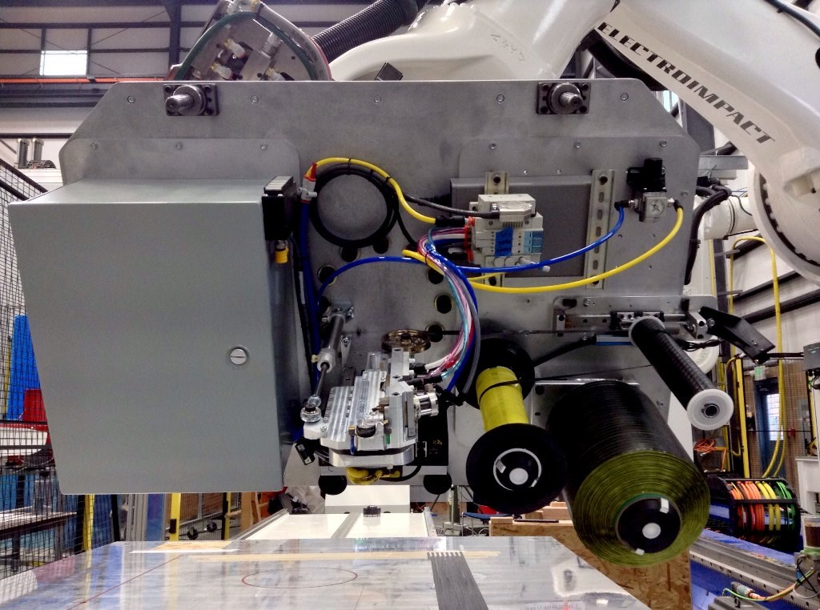
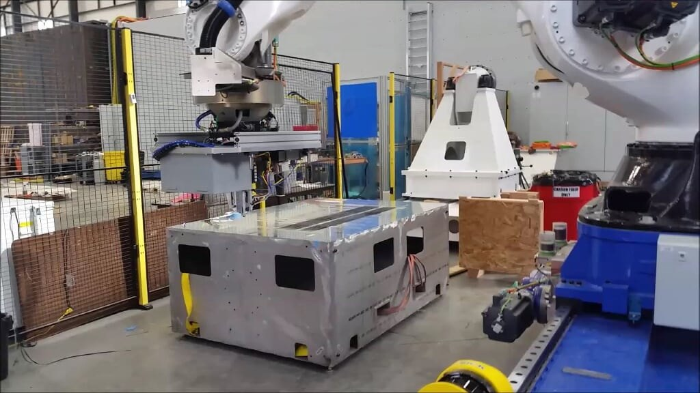
Robot Testing

Slide 17
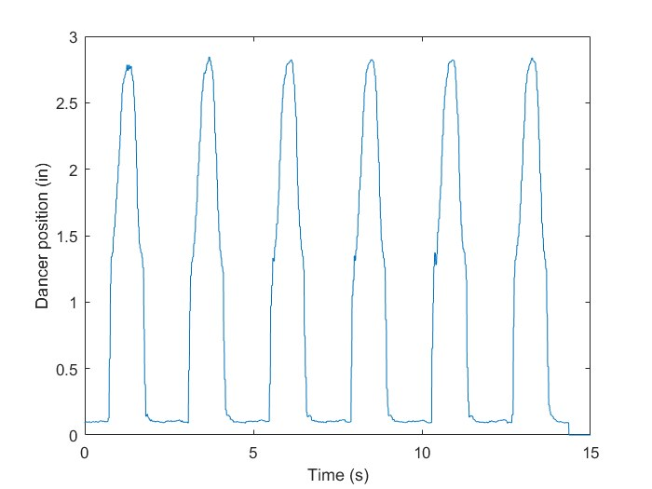
Robot Testing

Slide 18
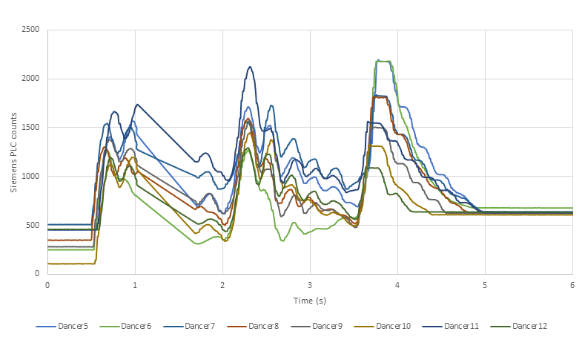
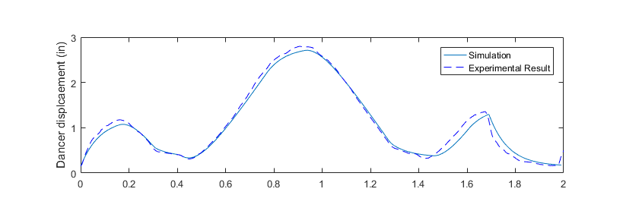
Typical Performance
PnEUMATIC
sERvo

Slide 19
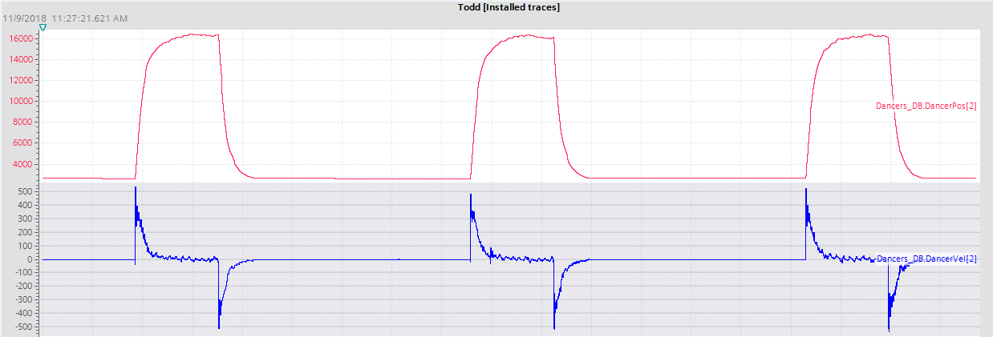
H16 Prototype

Slide 20
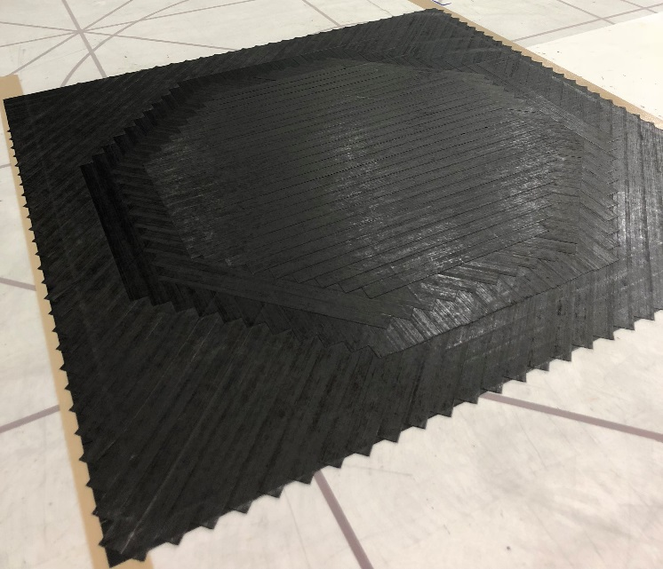
H16 Prototype

Slide 21

H16 Prototype

Slide 22
Overall Results
Goals:
↑ Reliability (MSBF)
↑ Add Speed/Cut Speed
↑ Top speed
↓ Average tension

Slide 23
Overall Results
Goals:
↑ Reliability (MSBF) (> 380% Increase)
↑ Add Speed/Cut Speed
↑ Top speed
↓ Average tension

Slide 24
Overall Results
Goals:
↑ Reliability (MSBF) (> 380% Increase)
↑ Add Speed/Cut Speed (88% Increase)
↑ Top speed
↓ Average tension

Slide 25
Overall Results
Goals:
↑ Reliability (MSBF) (> 380% Increase)
↑ Add Speed/Cut Speed (88% Increase)
↑ Top speed (17% Increase)
↓ Average tension

Slide 26
Overall Results
Goals:
↑ Reliability (MSBF) (> 380% Increase)
↑ Add Speed/Cut Speed (88% Increase)
↑ Top speed (17% Increase)
↓ Average tension ( >70% Reduction)

Slide 27
Overall Results
Customer benefits
Higher productivity
Less setup time
Less rework
Real time inspection
Real time error detection

Slide 28
Q & A
Questions

